Slide 1

Service Level Target Automation
For
BI Support Application
Date: Oct 09, 2017
Notes:
0

Slide 2
Agenda:
Application SLT Effort Saving
Sources of SLT Automation Data
SLT Automation Architecture
SLT Automation Process Flow
SLT High Level logic
Stored Procedure Data Flow
Software Used
Future Actions

Slide 3
Application Names:
These are the application for which service level automation is done
Application | GOC | Manual effort/month (Hours)
JSCEDW | Pharma | 18
GBI EDW | Pharma | 5.5
IQLIK | Pharma | 8
Vulcan IDM | Pharma | 11
Janssen Connect | Pharma | 5
Global Pricing | Pharma | 5
CONSUMER EDGE | Consumer | 22
GPIQ | Consumer | 8
BSC CANADA (Consumer) | Consumer | 9
BSC CANADA (Pharma) | Consumer | 9
Global Sales | Consumer | 2
JJDCC | Medical Devices | 15
EMEA | Medical Devices | 26
ASPAC |  | 22
Total Manual Hours saved |  | 165.5

Slide 4
Sources for SLT Automation:
Tidal:
URL: http://itsusrawsp04769/tidal_6_reporting/Job_Run.aspx
Tableau Extract:
URL: http://tableauedge.jnj.com/#/signin?redirect=%2Fsite%2FNAAI%2Fdatasources%3D
URL: https://prodbitabcon.jnj.com/#/site/Consumer/projects/369/datasources?order=hasAlert:desc
.NET Application:
URL: http://isis.na.jnj.com/isisrptdeliverystatus/ReportDeliveryStatus.aspx
Cognos Report:
URL: http://nacon.cogbi.jnj.com/1022/cgi-bin/cognosisapi.dll
QMC(Qlik Management Console) :
URL: https://navpc-qs.jnj.com/qmc
Oracle Database:
RedShift Database:

Slide 5
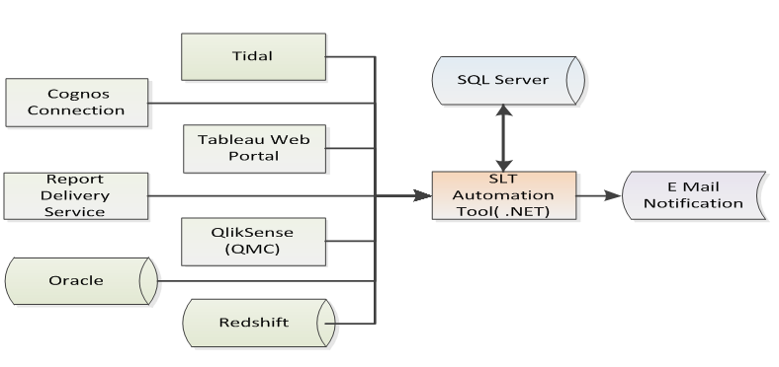
Service Level Target Automation Architecture:

Slide 6
SLT Automation Process Flow:

Slide 7
SLT High Level Logic:

Slide 8
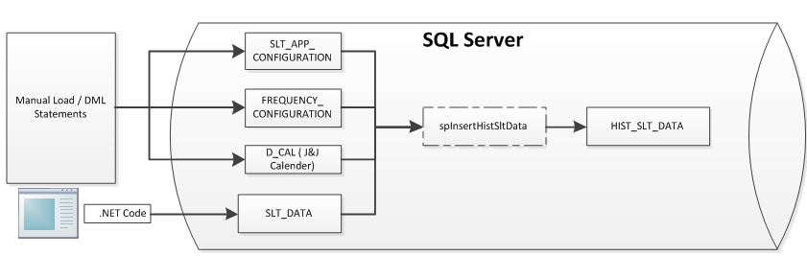
Stored Procedure Data Flow:
TABLE | DESCRIPTION
SLT_APP_CONFIGURATION | Contains the Job details like Estimated Start Time, Estimated duration, Frequency, Category etc.
SLT_DATA | Contains the actual start time and actual duration, Job Name, Job Group, Job Status.
FREQUENCY_CONFIGURATION | Contains the detailed date information for monthly jobs. Column Names: FREQ_DESC, MONTH, YEAR, FREQ_DT_VALUE, APPID
D_CAL | Contains J&J fiscal Calendar details.

Slide 9
Software Used:
.NET 4.0
Selenium
Microsoft SQL Server 2008
AutoIT
Google Driver
Firefox Driver
Future Actions:
Currently we are using support team credentials to login on websites which is encrypted and stored in database, Creating Service account for all the data source (Website/Database) of all the application.
Dedicated Server to run the SLT Automation code, No other application should run on the server while Automation code is running because AutoIT(performs like a recorded macro) will use the virtual keyboard of the system and enter the values in into the browser.
Database to store the data for SLT Automation.
Web User Interface to show status of Application which is running and when job started.
Web User Interface to start Ad-hoc run for given application
Web User Interface to kill the application which is running, it will be helpful in some cases.

Slide 10
TDS:

Slide 11
Thank You

